Slide 1

Week 4 Review
Alessio I., Gursimran K.

Slide 2
Lambda Acceptance and Efficiency Study
Lambda particle gun from origin, 25mrad, 0 to 270 GeV lambda momentum, current ZDC design, 140k events (before cuts)
Goal is to find what are the characteristics of events which the ZDC could potentially reconstruct
Two parameters: Lambda momentum, Lambda decay distance
Determined candidate events by checking if neutron and 2 gamma land in Ecal (determined by using MC truth momentum vectors and decay vertex)
Additional cuts remove beam pipe collision events

Slide 3
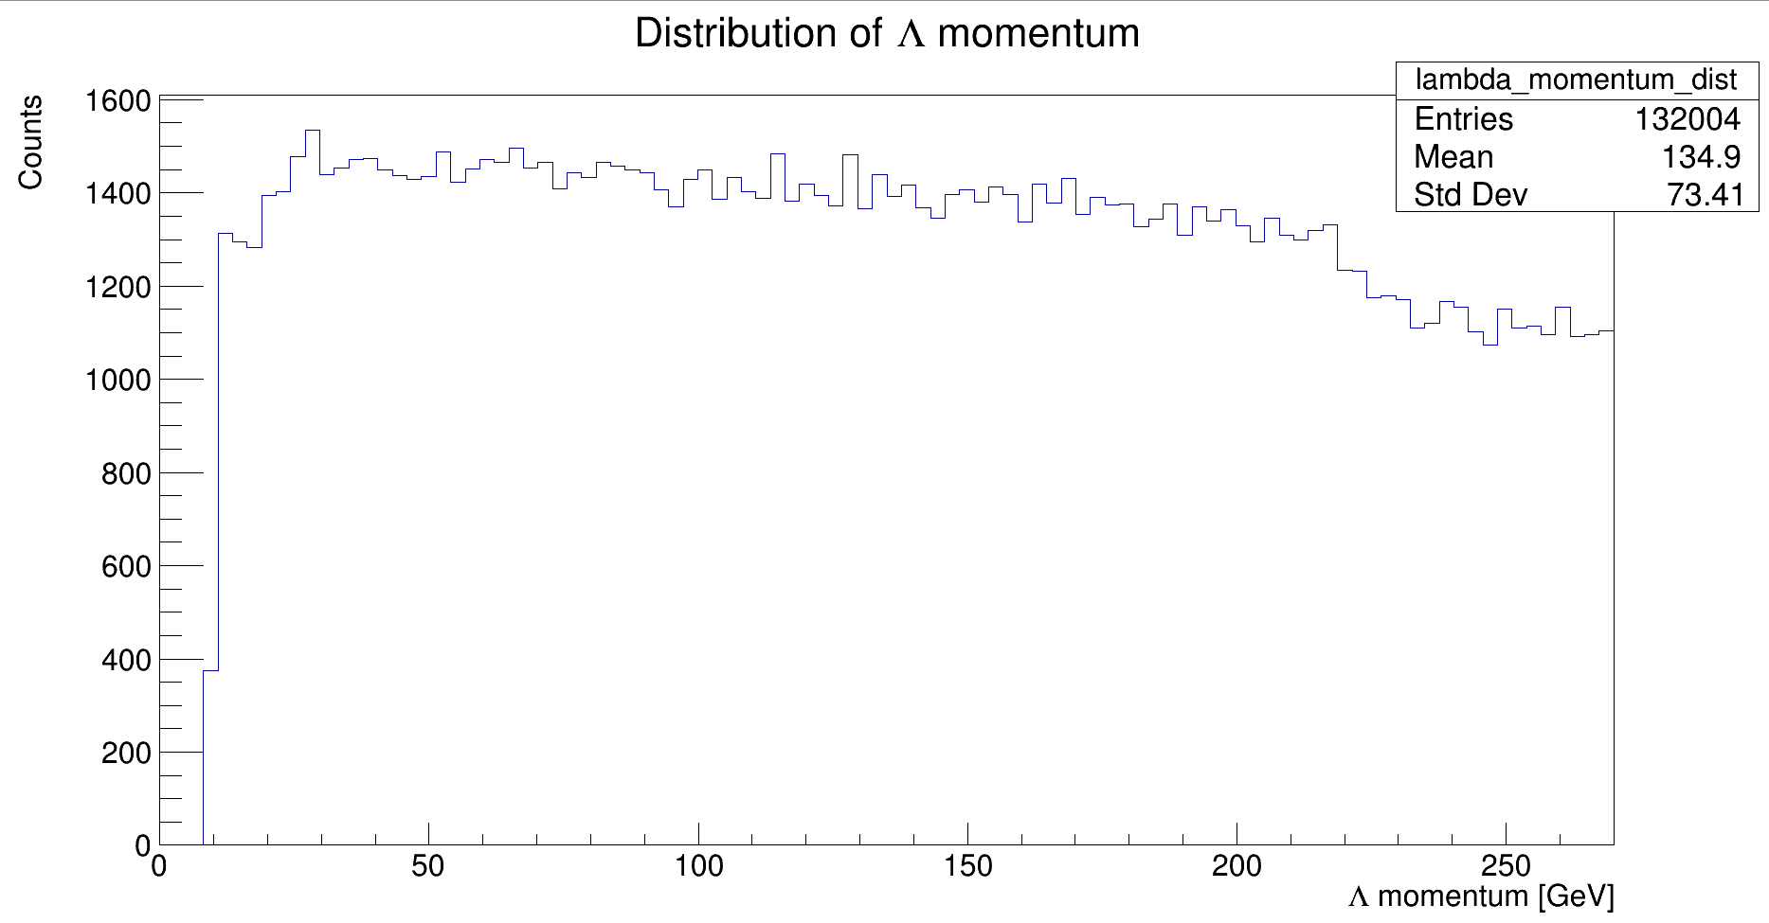
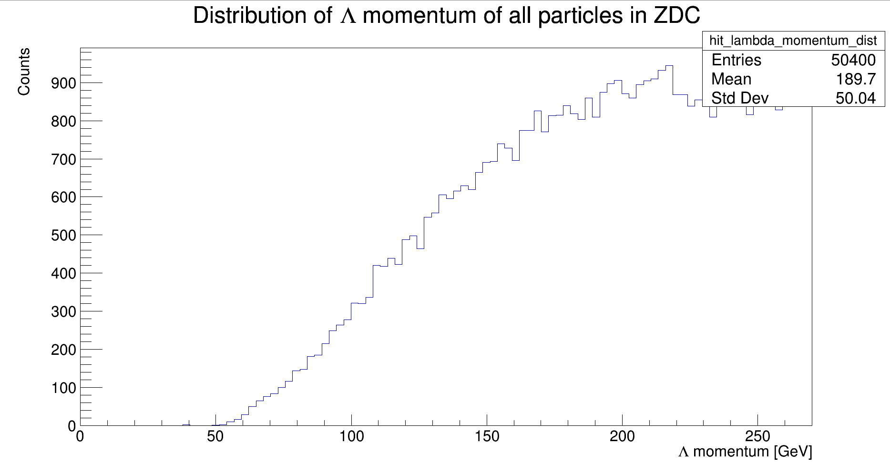
Momentum Distributions

Slide 4
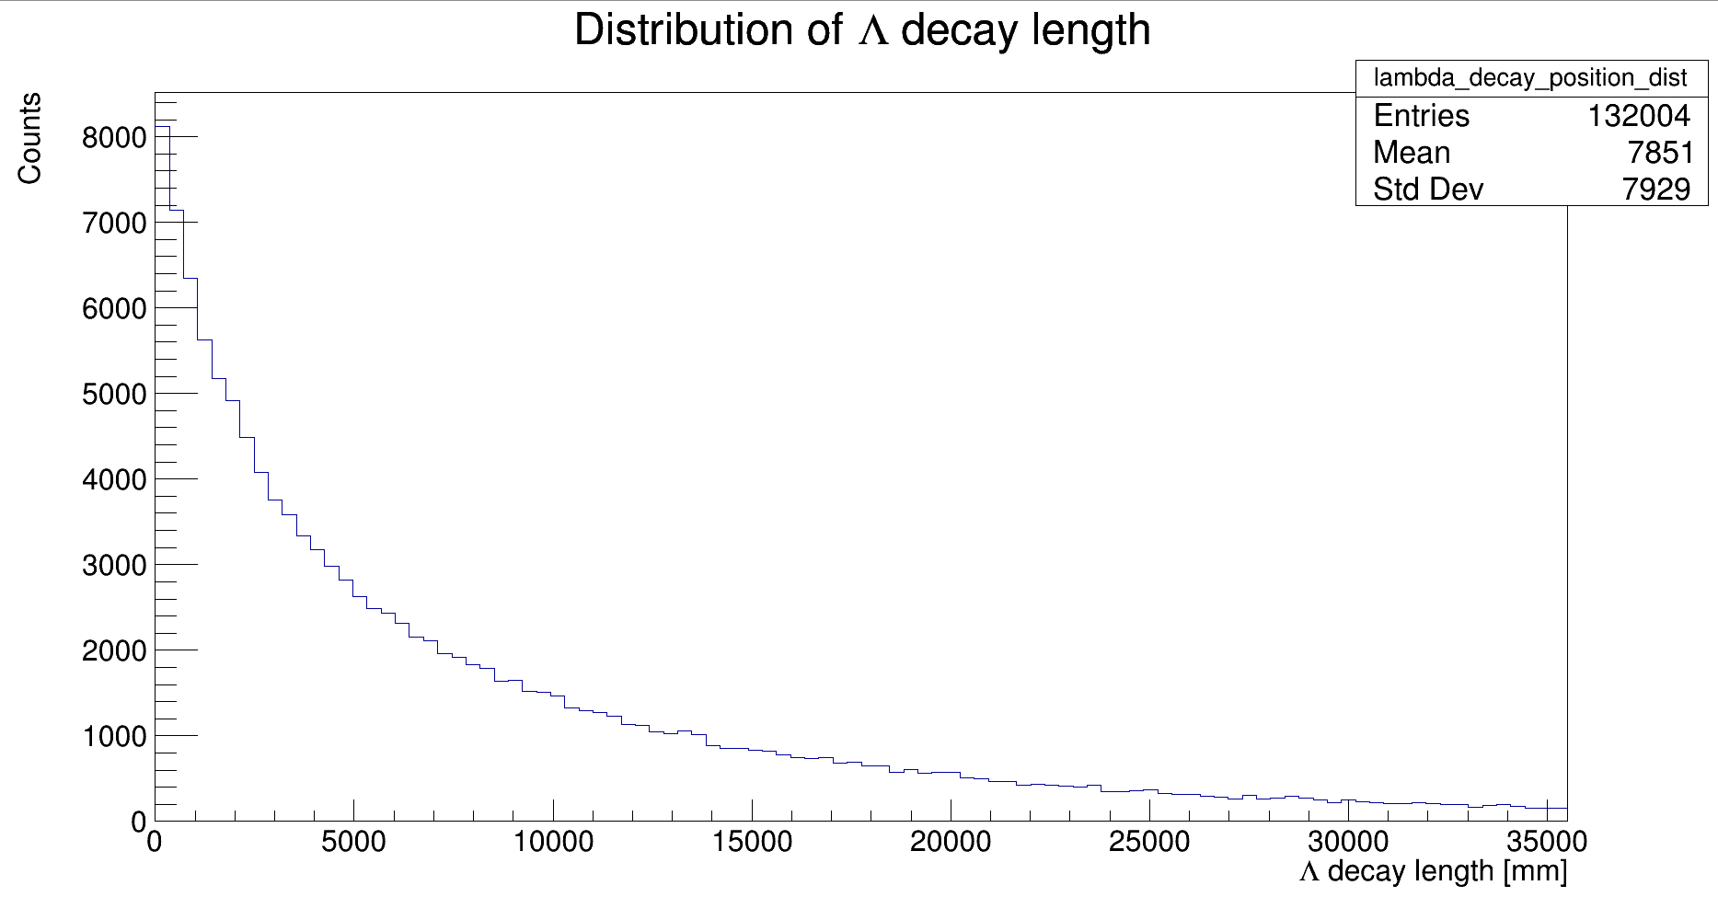
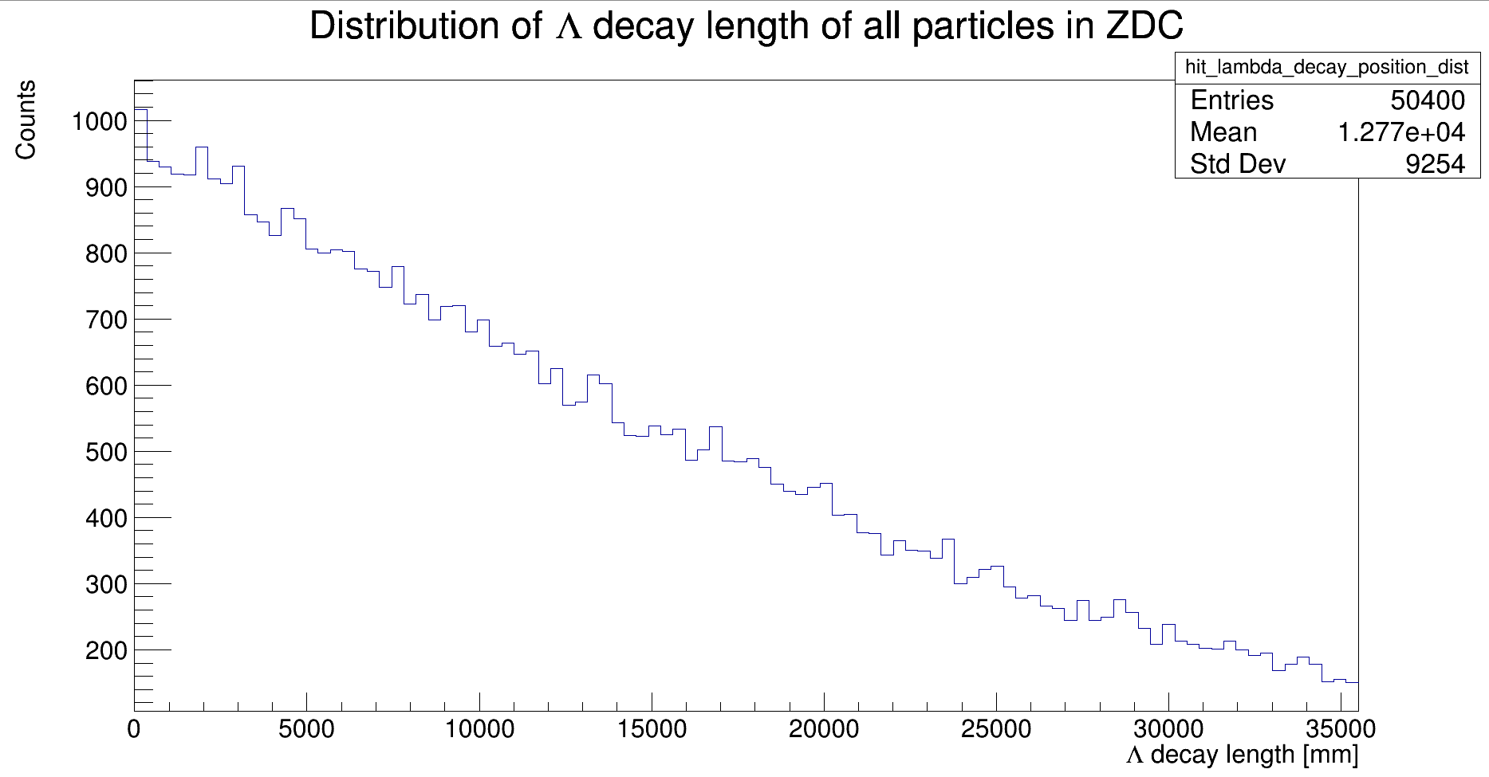
Decay positions

Slide 5
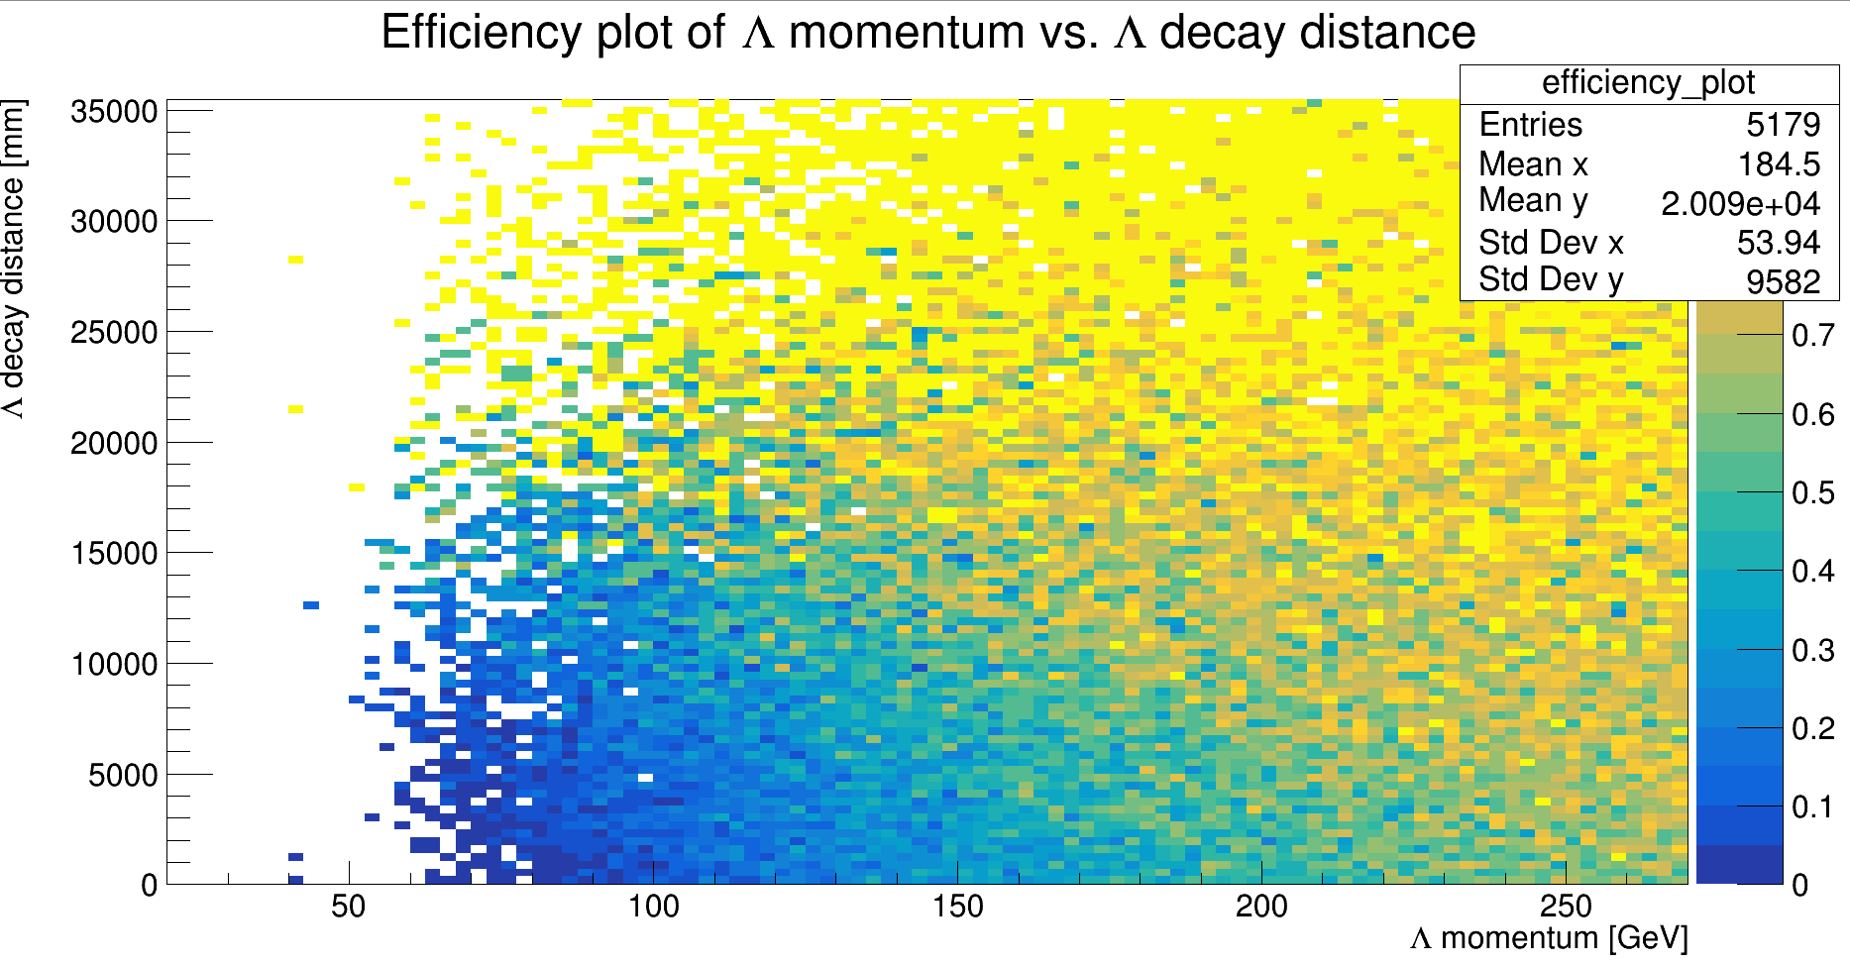
Efficiency Plot

Slide 6
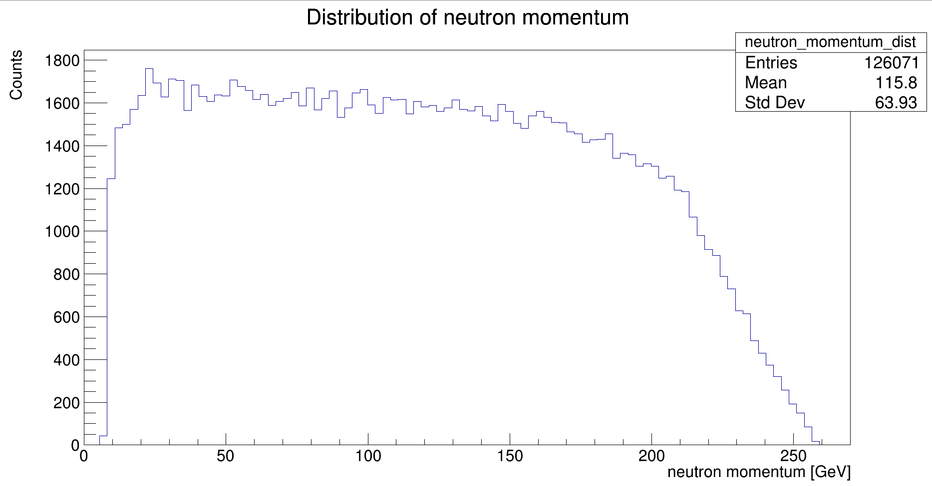
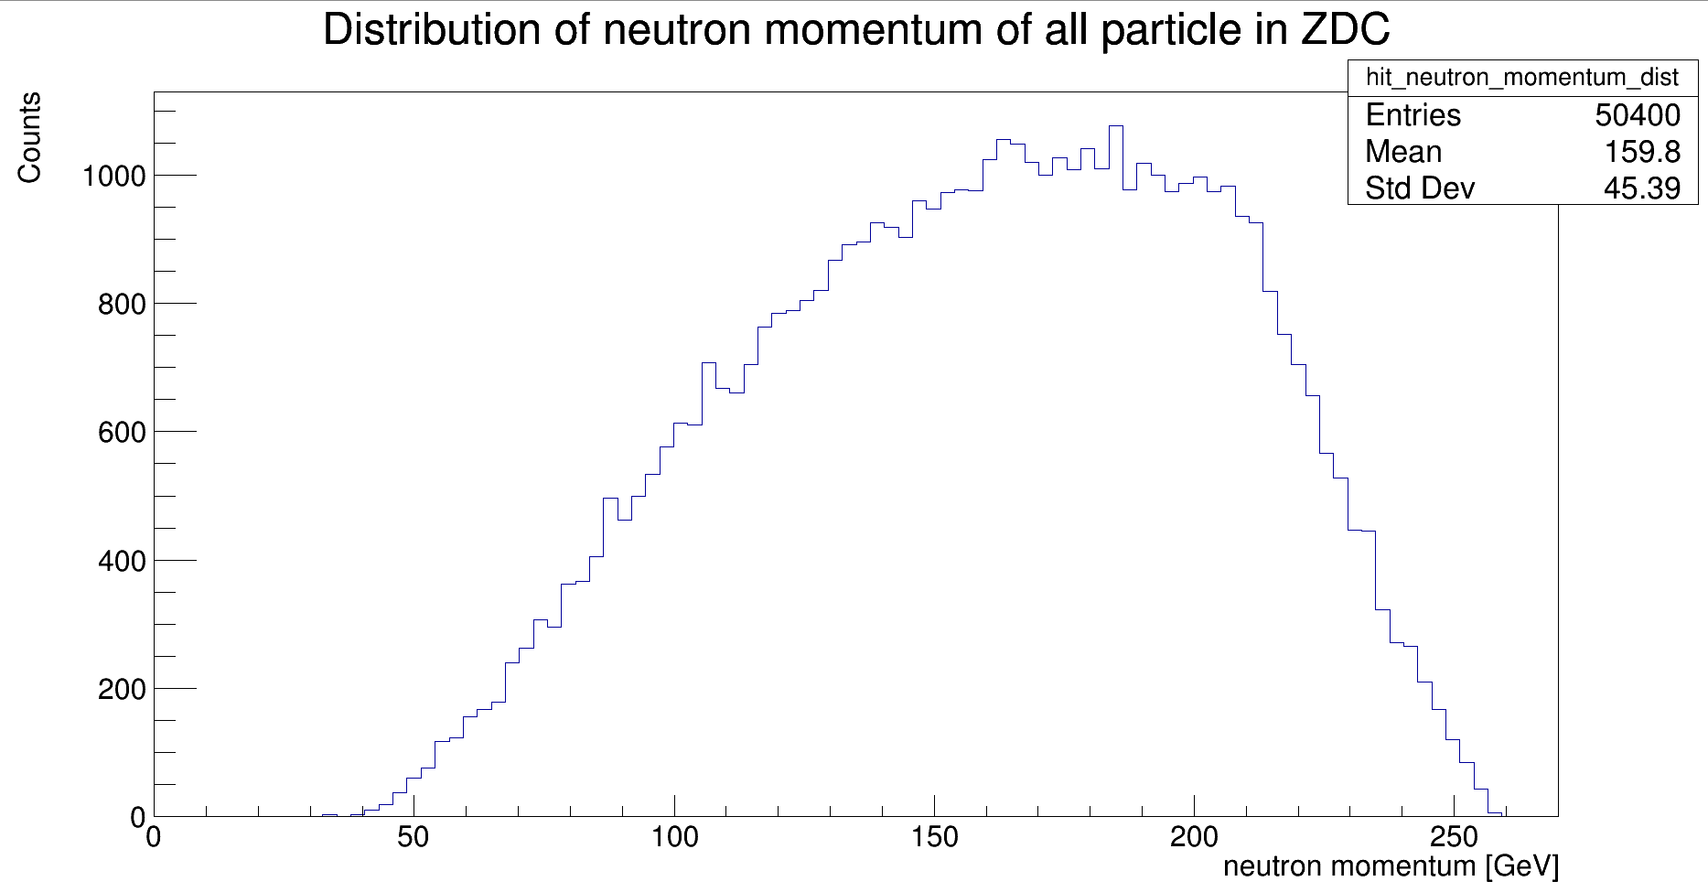
Neutron momentum

Slide 7
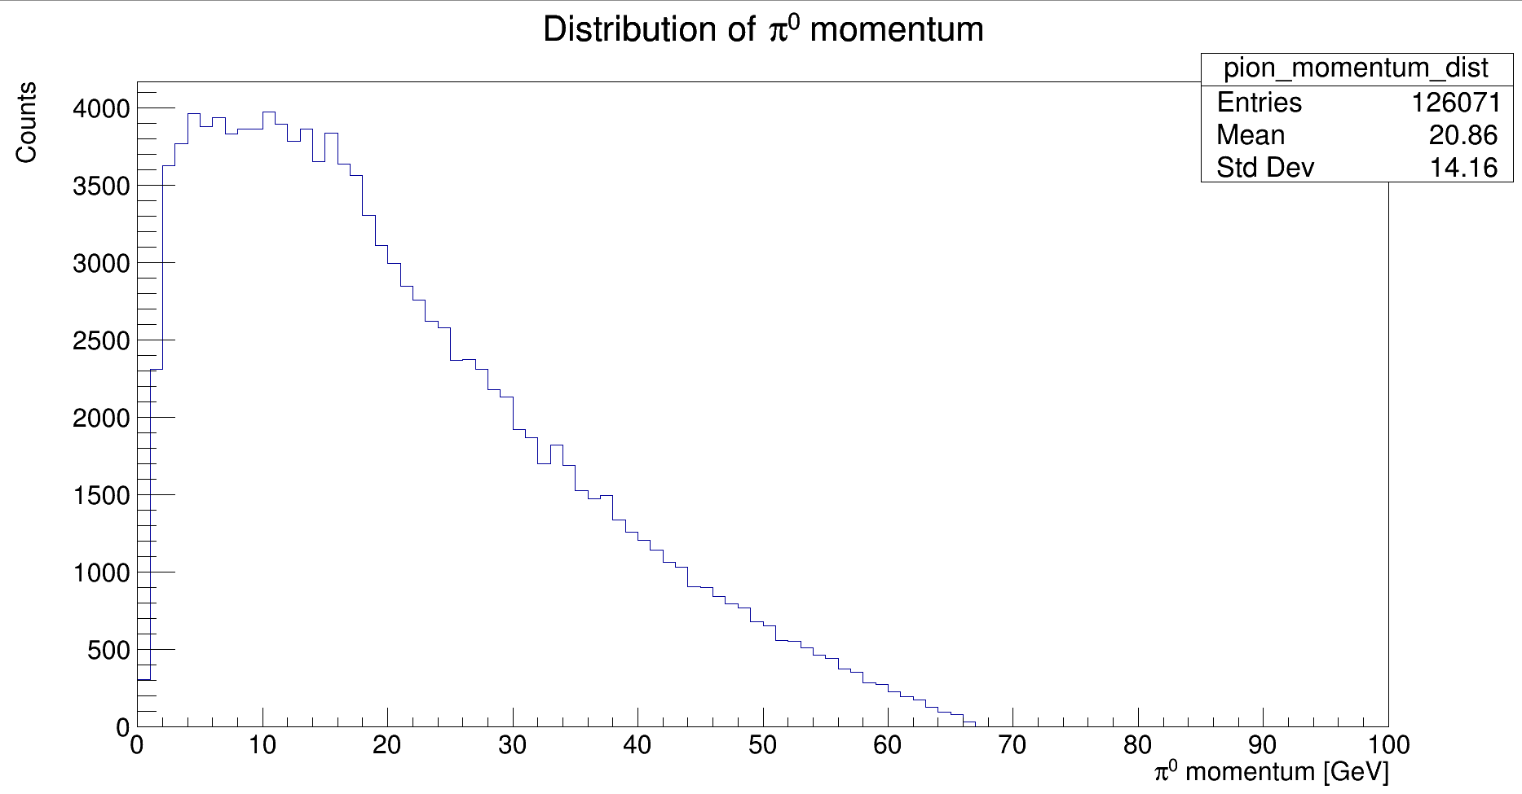
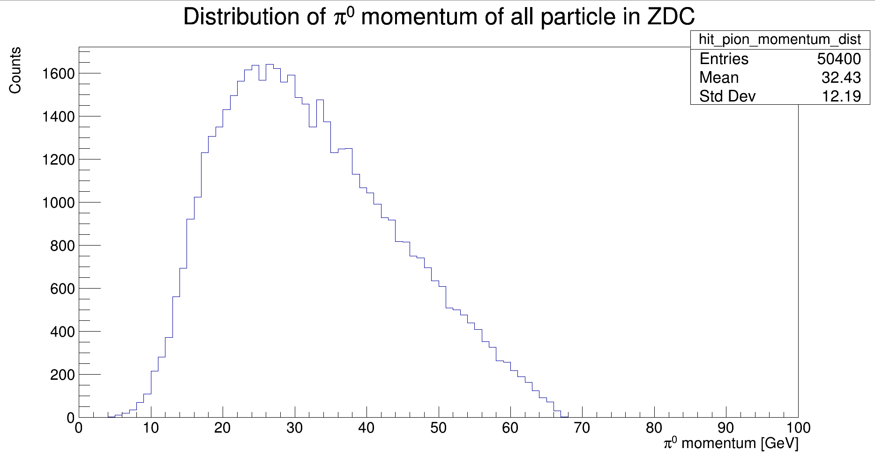
Pi0 momentum

Slide 8
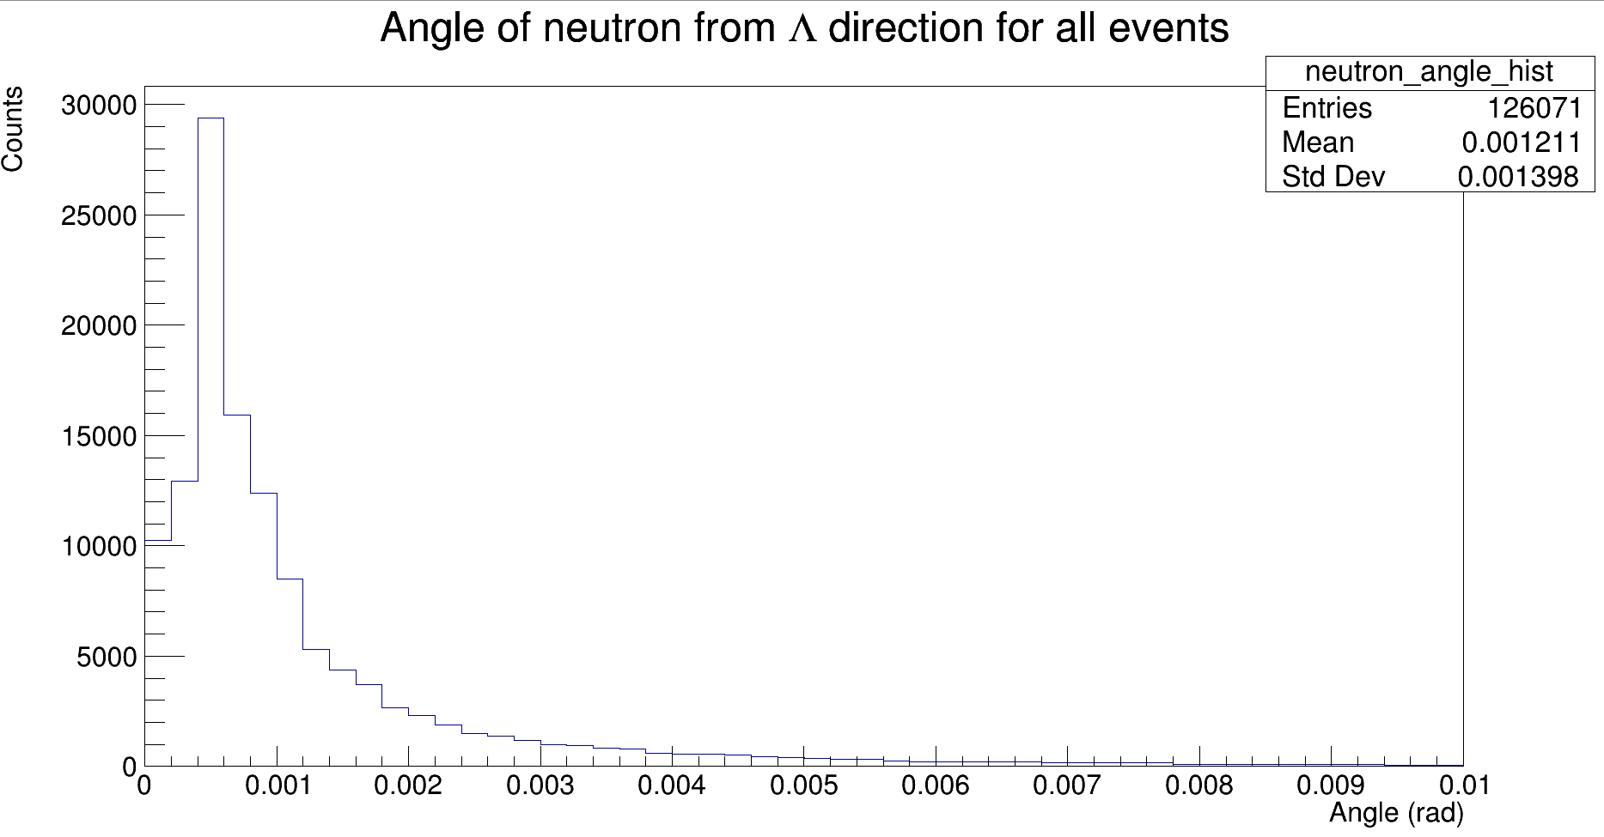
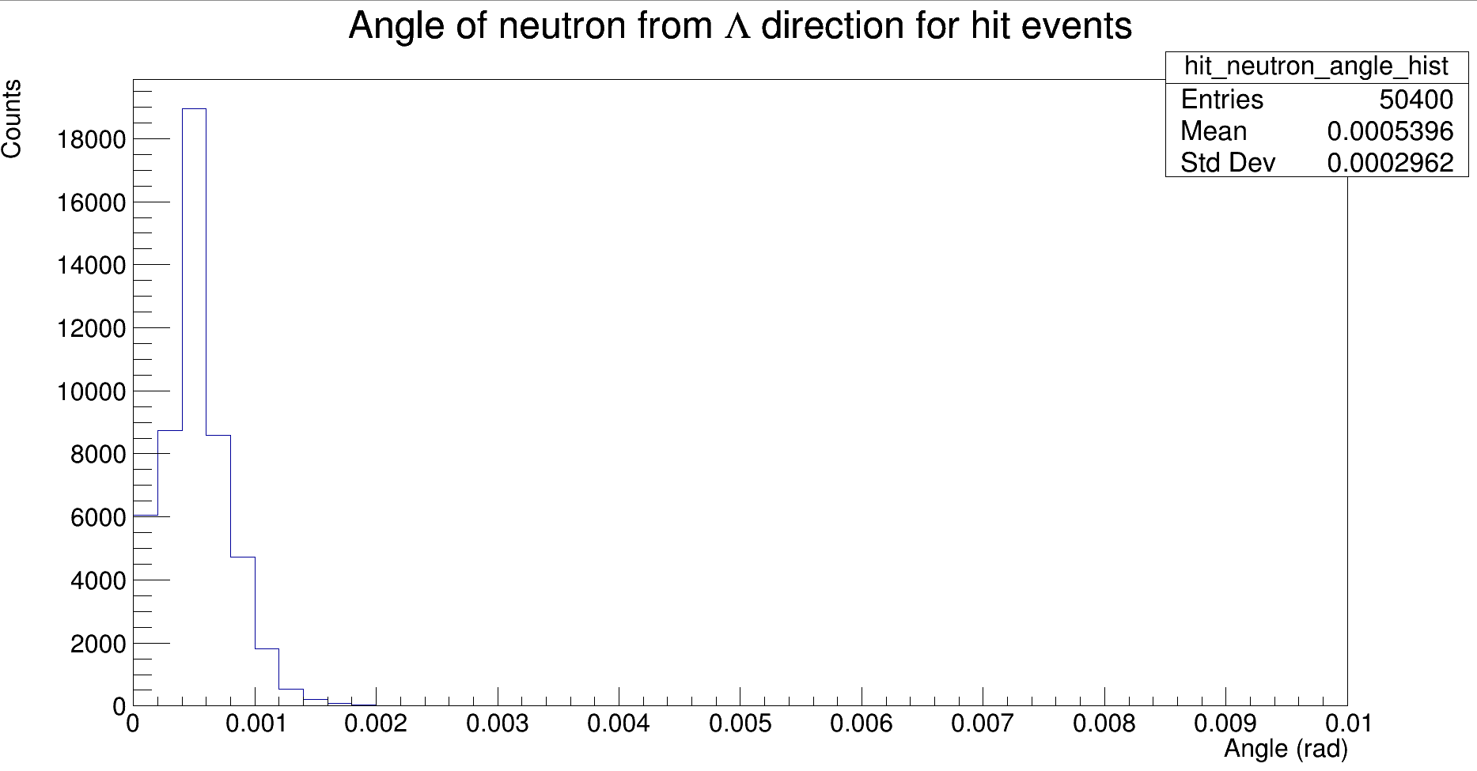
Neutron angle from Lambda direction

Slide 9
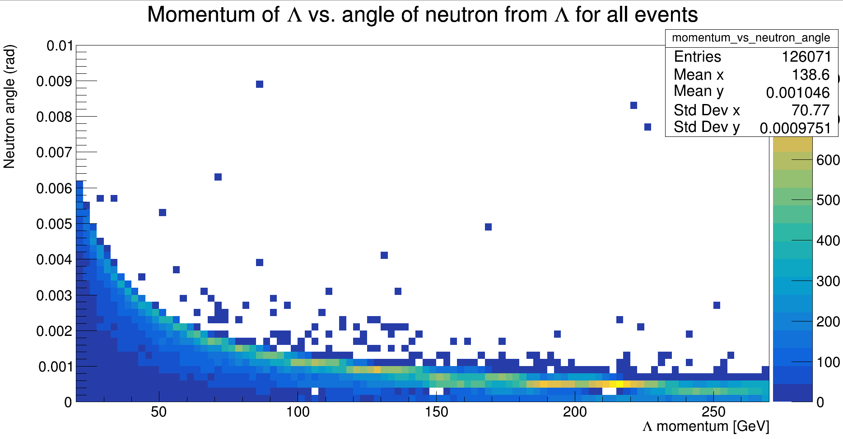
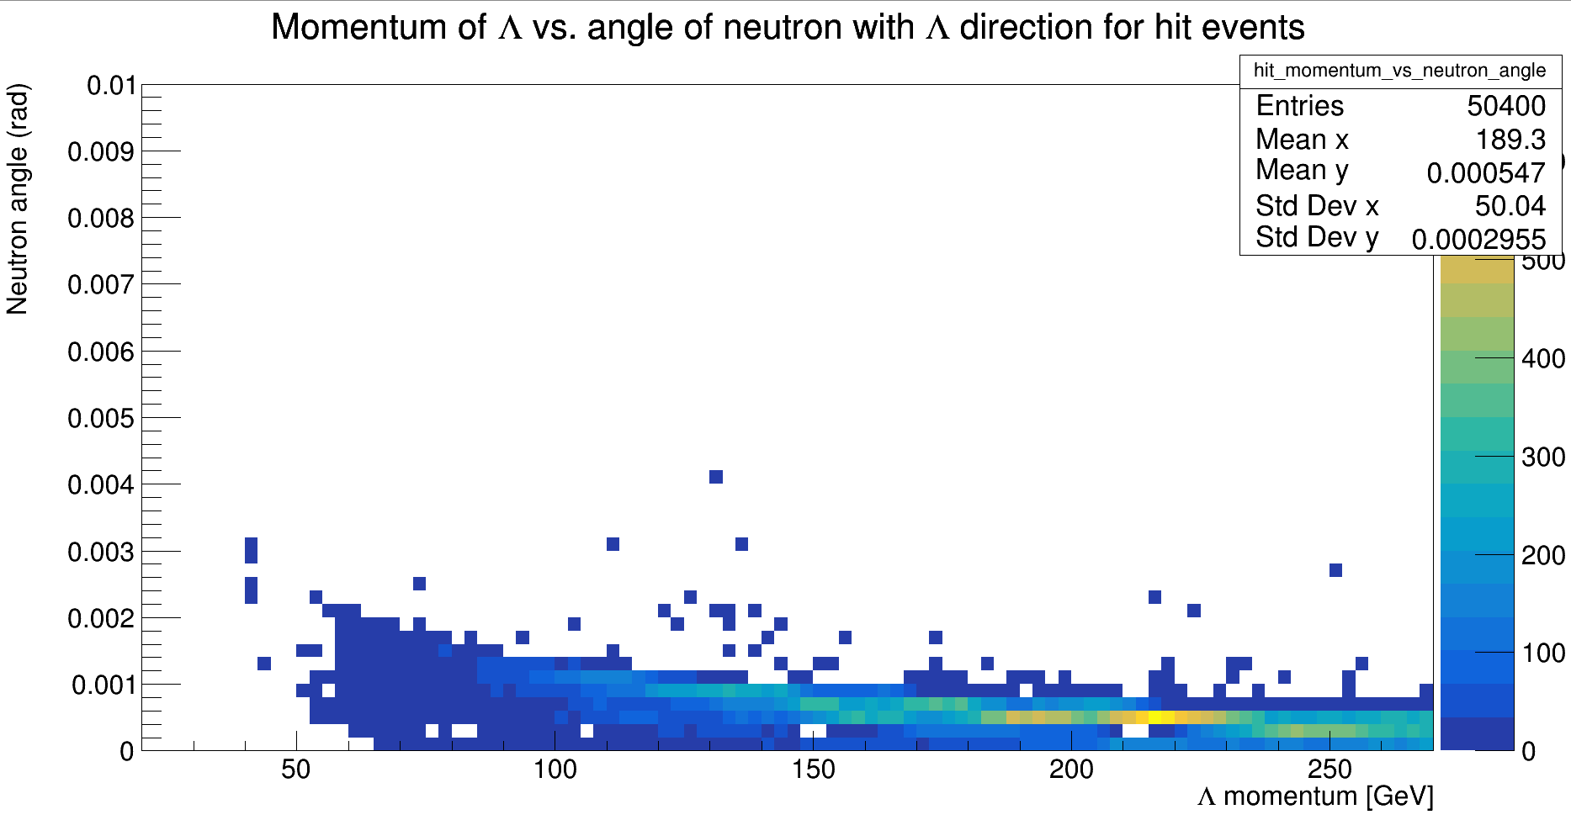
Neutron angle from Lambda direction, function of Lambda momentum

Slide 10
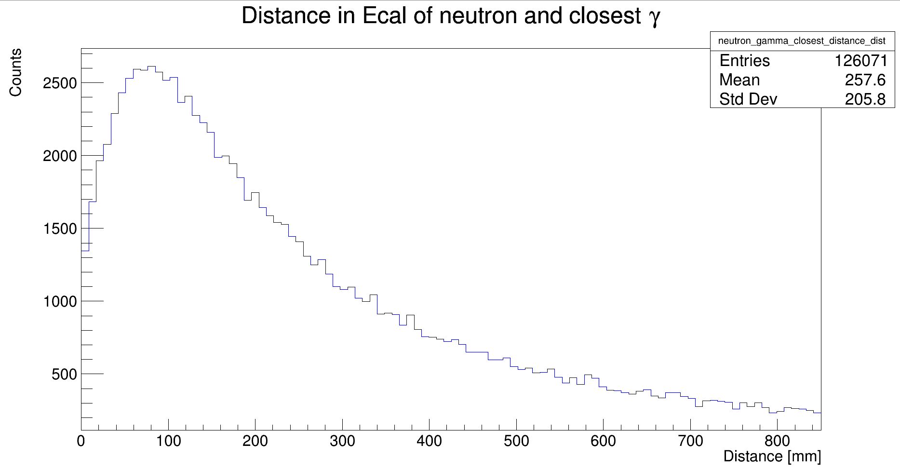
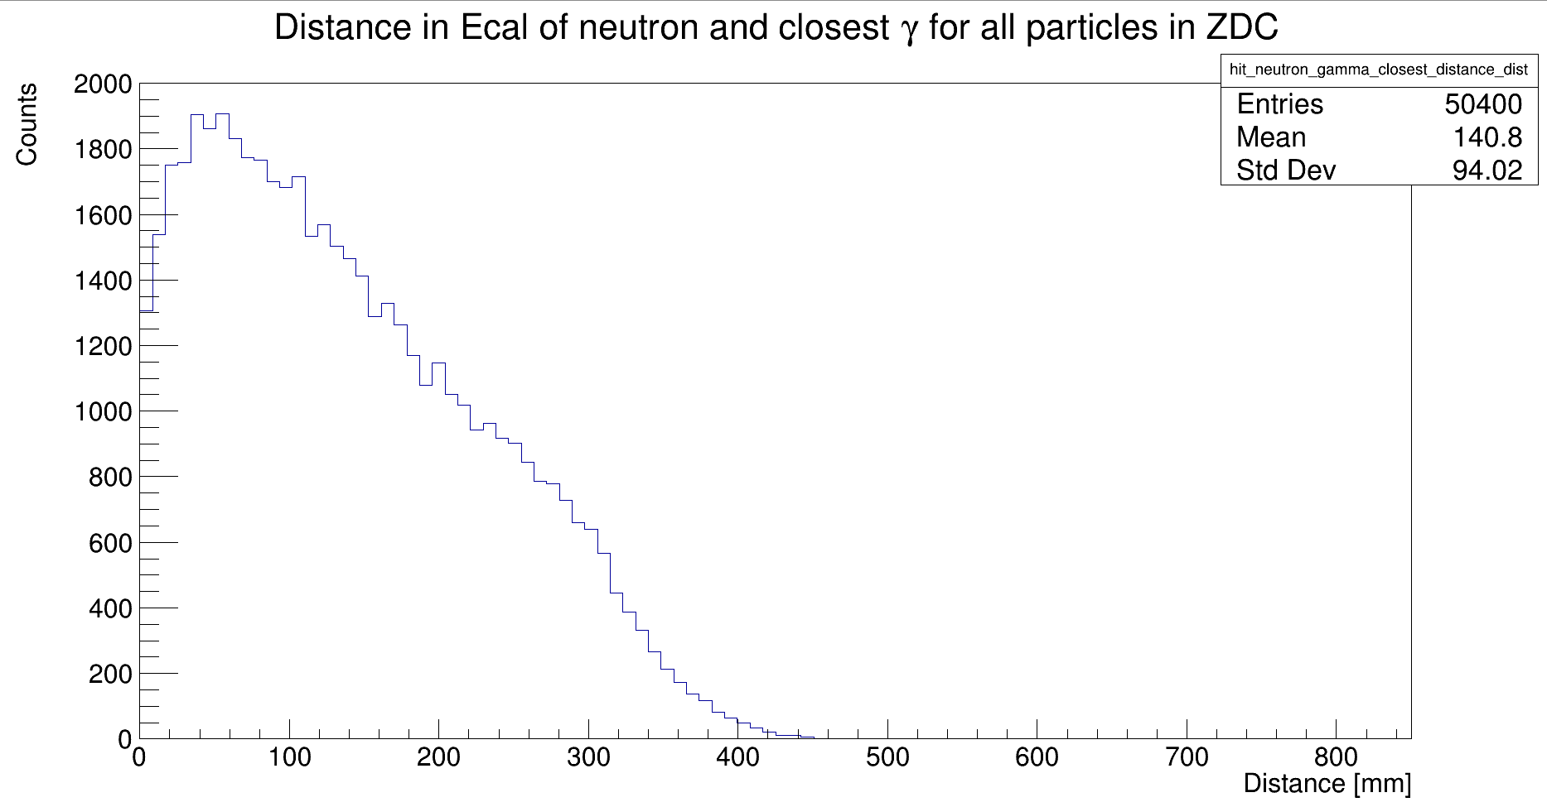
Distance between neutron and closest gamma

Slide 11
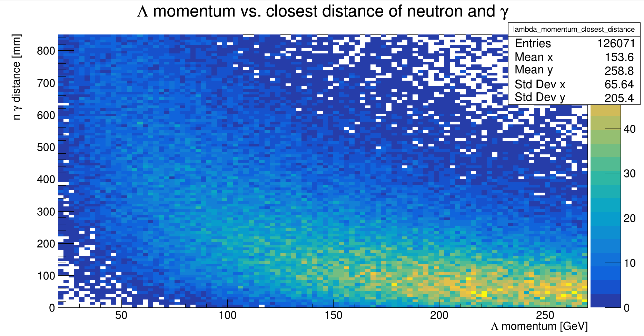
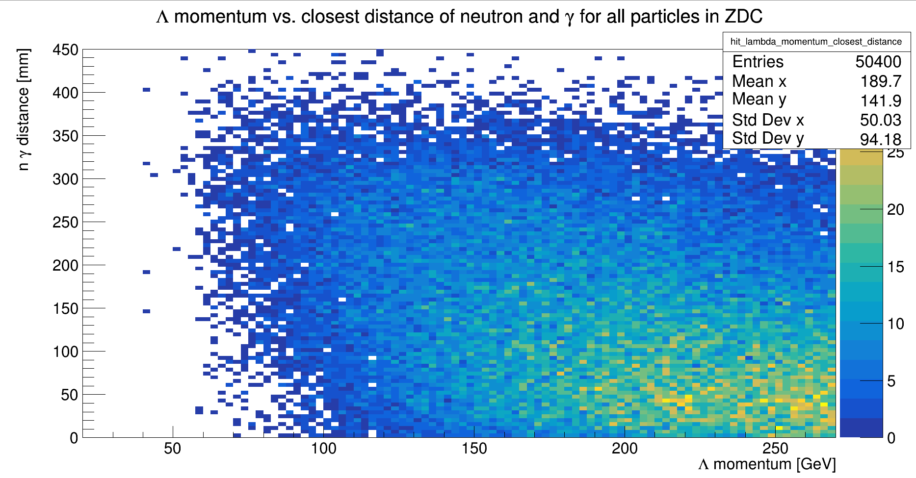
Closest distance of neutron to a gamma vs Lambda momentum

Slide 12
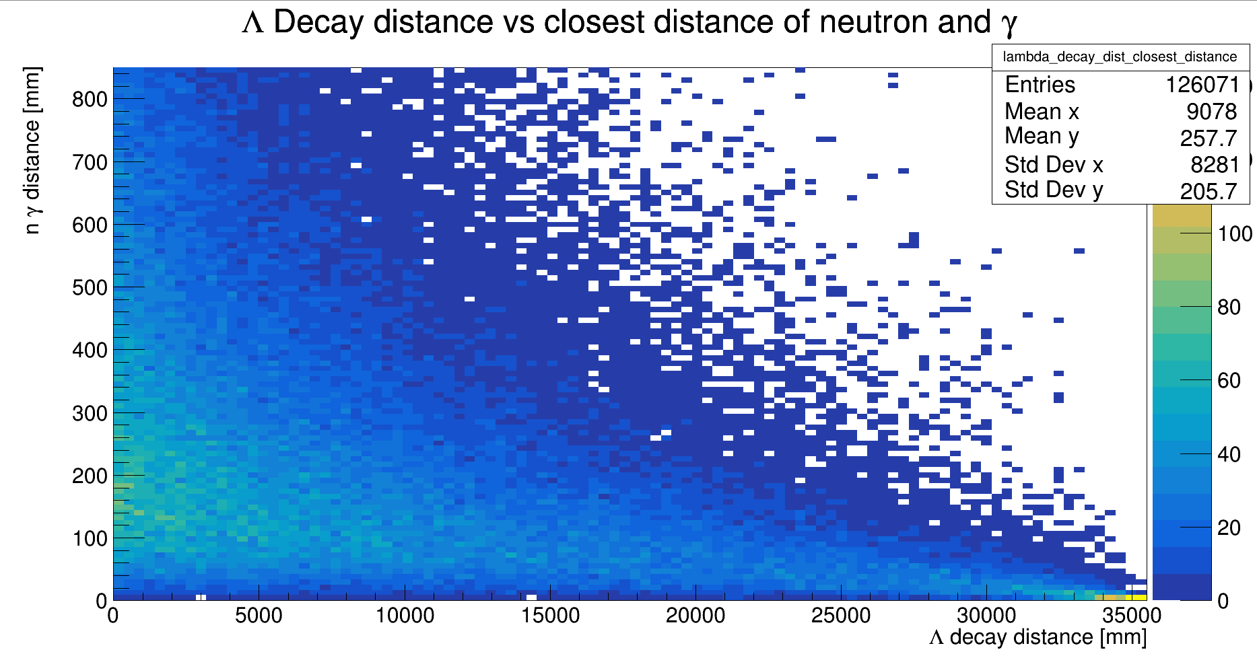
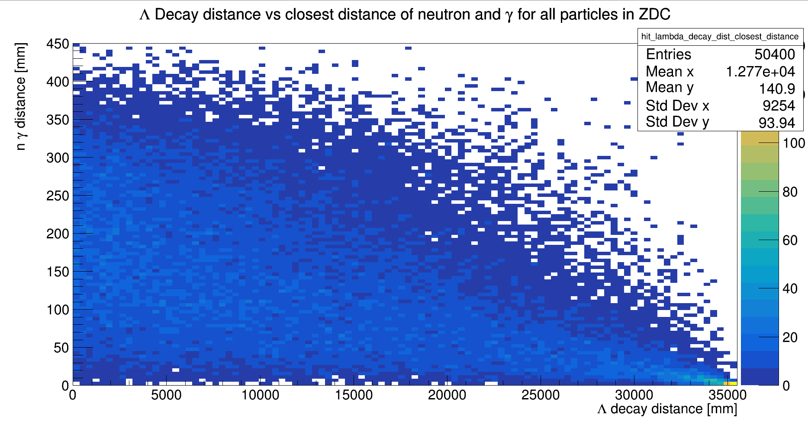
Closest distance of neutron to a gamma vs Lambda decay position

Slide 13
Additional Notes and Updates
New version of Firebird to be posted soon, plots of the showers coming soon
Ongoing work to understand how the edm4hep files provide hit contributions, we do not yet completely understand how this information is stored (this will be vital for clustering)
Work has begun on clustering Ecal and Hcal hits, one focus is unsupervised NN and another is a layer-by-layer, energy density clustering
Clustering algorithm also needs a PID algorithm (Potentially very simple)

Slide 14
TPC Construction and testing
GEM and alpha source was placed into TPC and top was sealed
Double checked that field and GEM HV had correct resistances to GND, attached pre-amplification circuit to signal
Set up CAEN power supply for field voltage (-1000V) and GEM voltage (1320V)
Attached output to oscilloscope, observed "signal" in N2 indicating sparks
Continued seeing false signal with P10
Turned gas off and opened up TPC to retape circuit board and other parts
Continued to see false signal

Slide 15
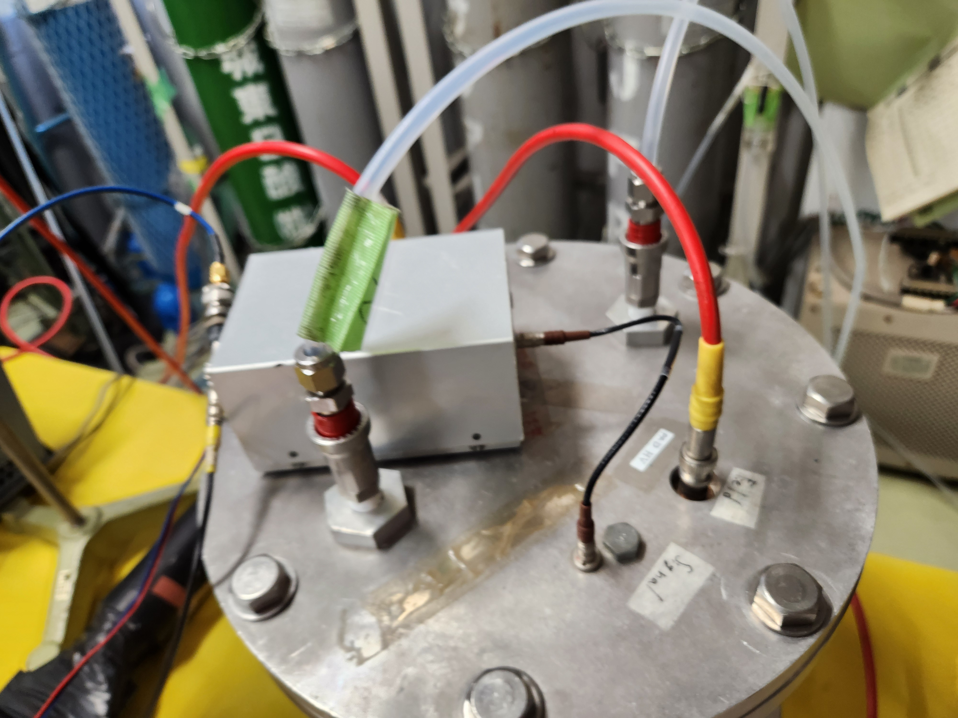
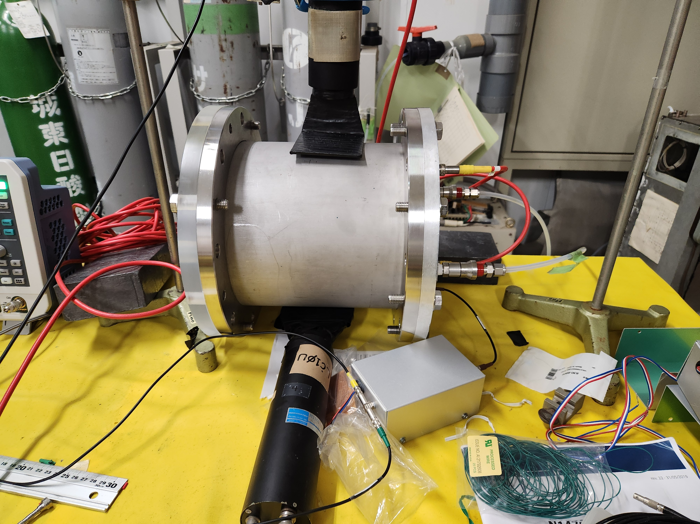
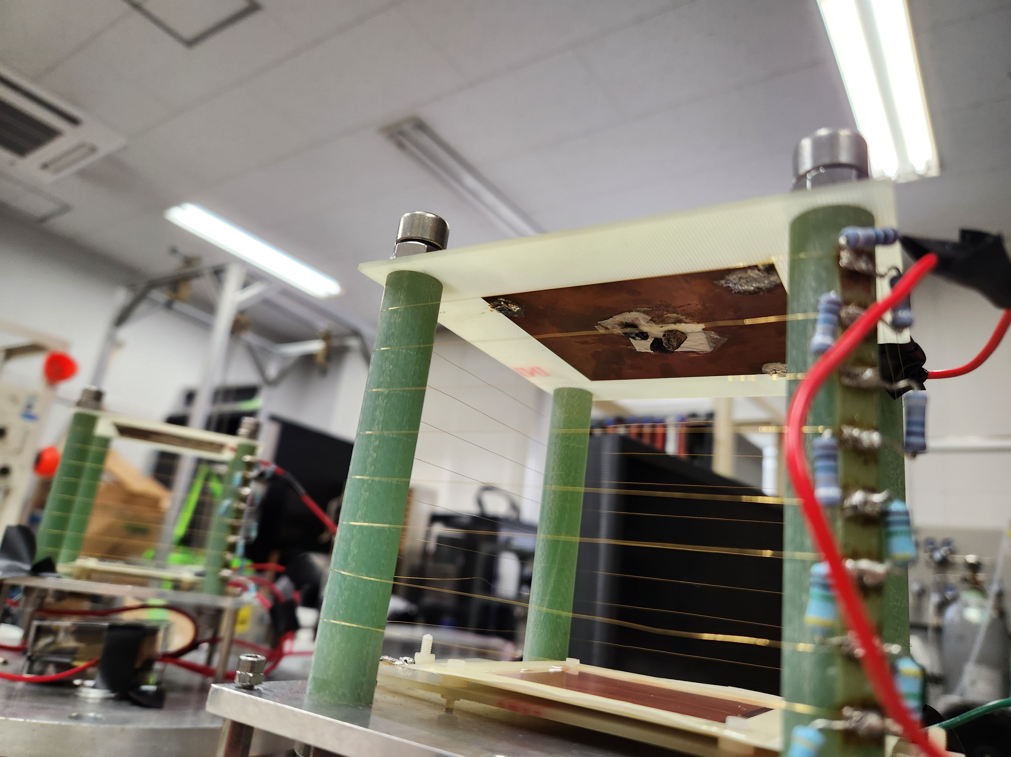
TPC Photos

Slide 16
Goals for this coming week
Generate and analyze lambda data with various angles with the aim to determine what the acceptance for non-zero angles is
Show showers in ZDC with/without WSi using Firebird
Start data processing and start testing clustering algorithms
Continue debugging TPC
Set up TPC DAQ (if possible), start taking data with oscilloscope

Slide 17
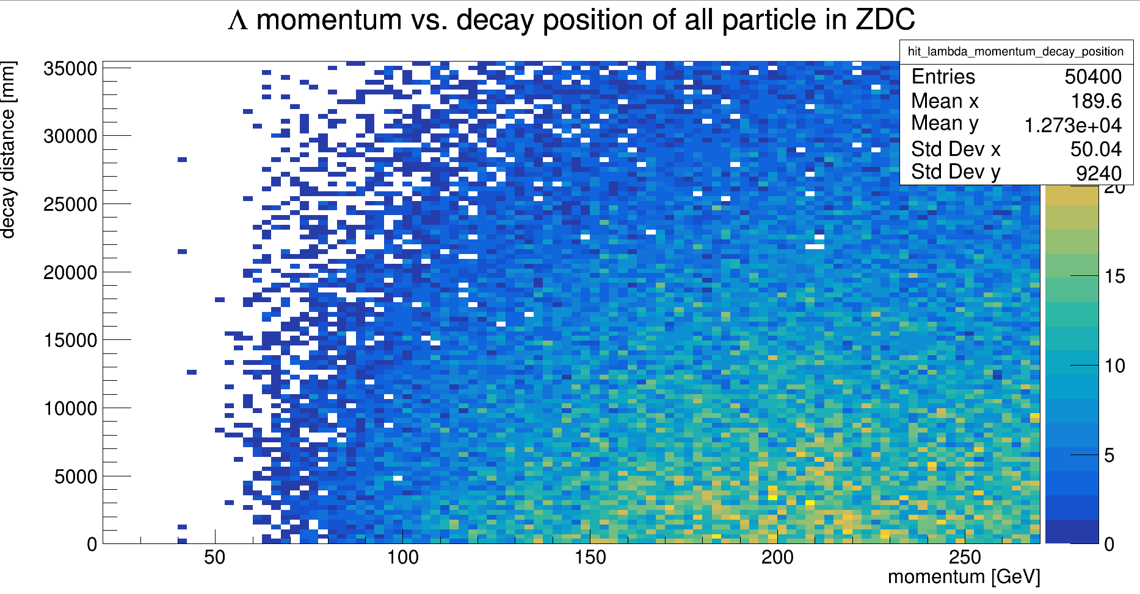
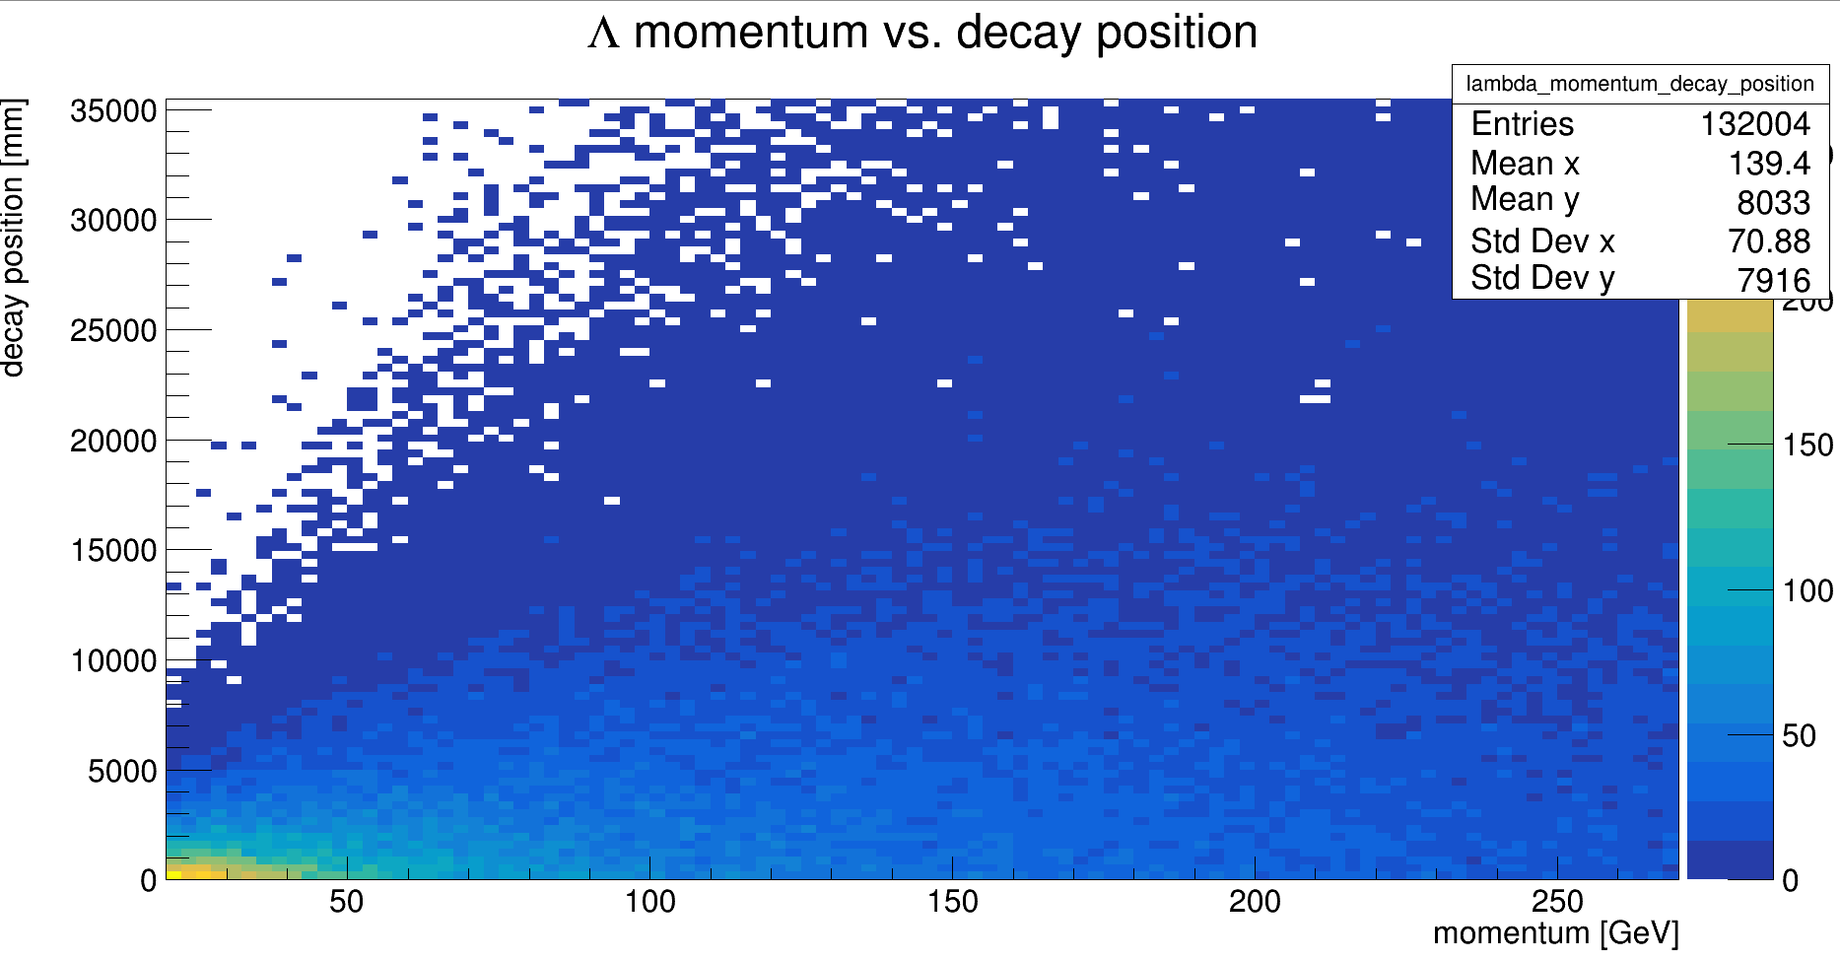
Extra Plots 1

